Slide 1
TurkStat Web Content
Management System
31.03.2014
(Muscat, Oman)
Notes:
TurkStat has a software to deploy

Slide 2
        TurkStat Web Content Management System Software
        is used for loading :
Press Releases
Metadata of the Press Releases
Statistical Tables
Anouncements
Frequently Asked Questions
..
Notes:
is used for loading data Manually.
İt is for Static Data

Slide 3
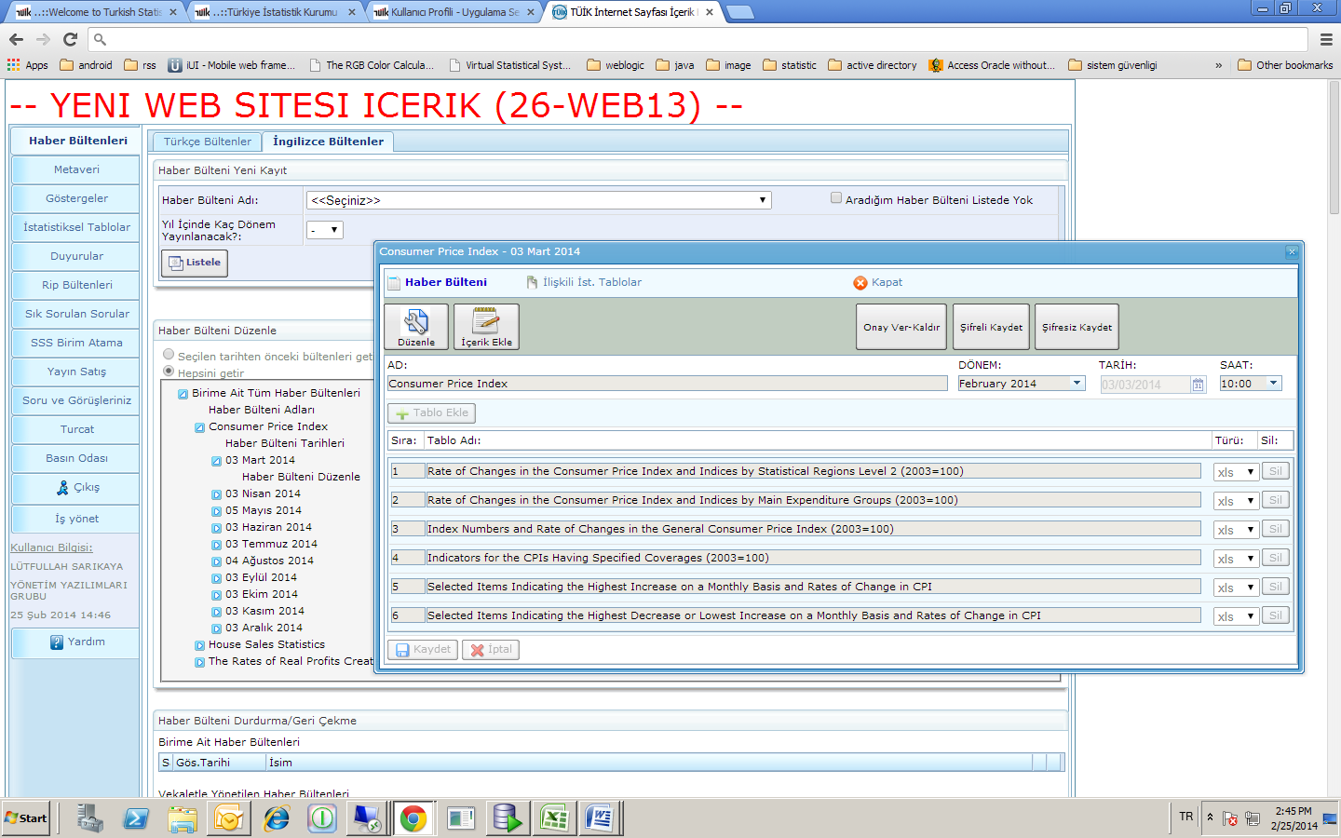
Preparing press releases

Slide 4
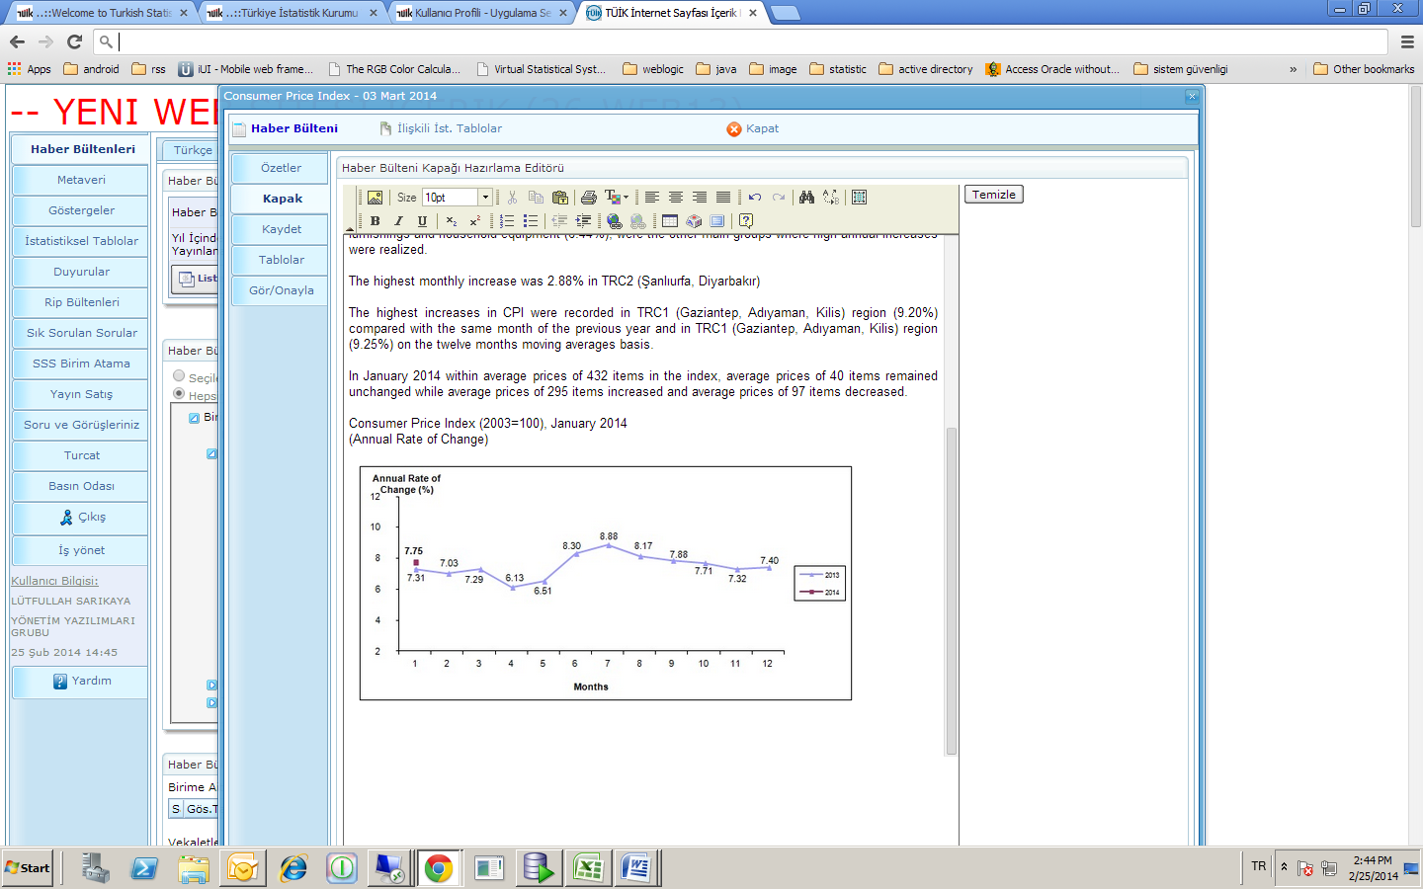
Loading Press Release Content

Slide 5
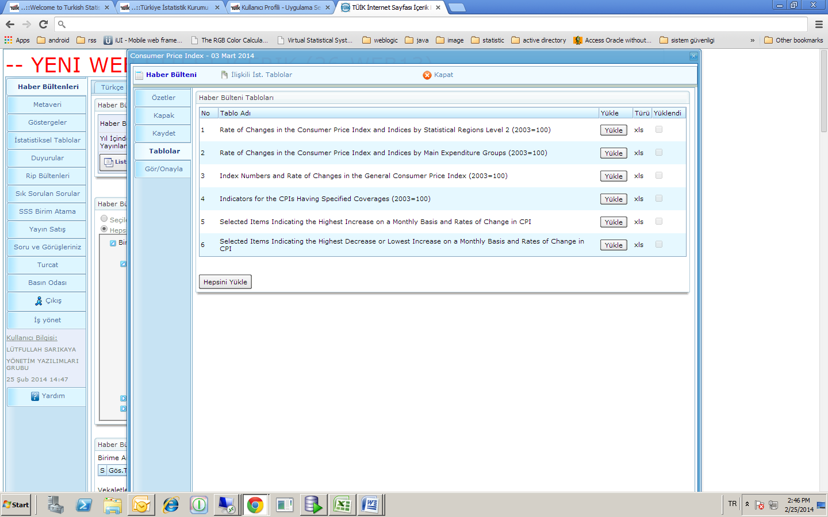
Loading tables as attachment of the press releases

Slide 6
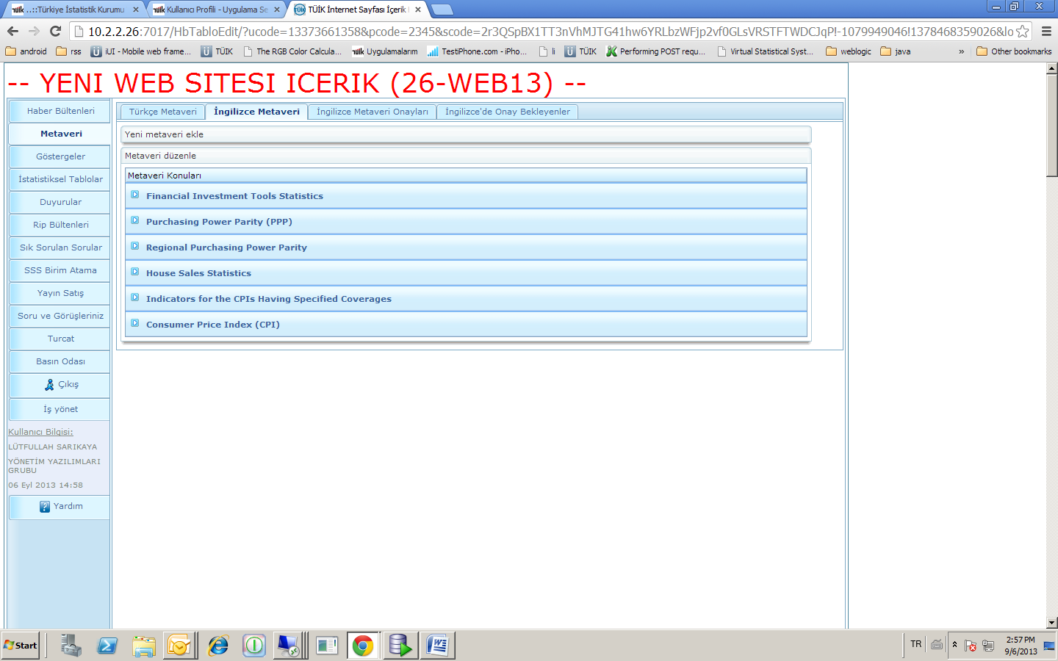
Loading Metadata

Slide 7
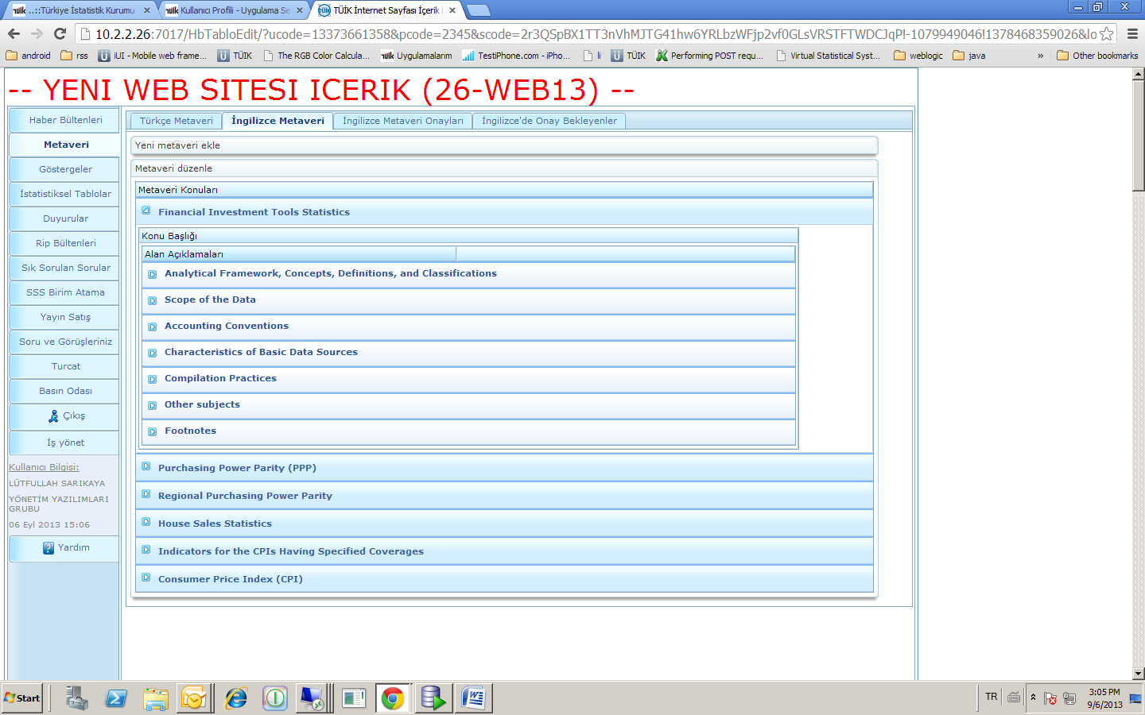
Loading Metadata Details..
Notes:
We can see the details of metadata on this screen.

Slide 8
Conclusion
Autherization mechanism exists
Confirmation mechanism exists
After department loads press releases, software encryptes data while writing database until the bulletin time
Subscription to press releases, statistical tables is available on web page

