Slide 1
DATABASE DESIGN
31.03.2014 (Muscat, Oman)

Slide 2
OUTLINE
Database and Database Management System Definition
Database Design Steps
Entity-Relationhip (ER) Model
Conceptional Data Design
Logical Database Design
Physical Database Design
Normalization
Denormalization
DB Design Examples and Key Points

Slide 3
What is Database ?
A database is an organized collection of data
“It is hot today” => Not a data
“It is 5 C degrees” => Data
One can insert, update or delete the data in the database
directly or via a web program, etc.
Today, databases are totally in our lifes: internet shopping,
banking, administrative registers etc.

Slide 4
Database Management System (DBMS) is a software designed
To assist, managing, maintaning data.
Main Functions of the DBMS:
Make new databases
Define the concept of the database
Store data (Different types of data available)
Protect data
Query data
Encrypt data
Controlling access rights
Synchronize accesses
Organization of physical data structure
An alternative to DBMS may be using text files that are less complex

Slide 5
Advantages of DBMS
Can deploy huge size of data
Controlling redundancy
Data independence from applications
Reduced application development time
Efficient data access, techniques for efficient query
Data integrity with using referantial integrity techniques (data consistency)
Security, autherization for multiple users
Easy data administration
Backup and recovery mechanism

Slide 6
Disadvantages of DBMS
Size – very large
Complex
High cost
Increased hardware requirements

Slide 7
DATABASE DESIGN STEPS
Think before doing it !
Requirement Analysis
Conceptional Design :
Relational Model (E-R Modelling)
Hierarchical Model
Network Model
Object Oriented Model
Logical Design
Physical Design

Slide 8
Requirement Analysis
During this phase, the below questions must be answered:
What will the system serve for?
Which requirements will this database meet?
Which data will this database store?
What will the tables of this database be?
Upon completing the answers for these questions on paper,
passing to the conceptional design can be advantegeous for your work.

Slide 9
ENTITY-RELATIONSHIP MODEL
ER Model is the concept of the Relational Databases.
ER Model describes data model using objects ( Entity) and their relationships
Entity :
is an object that exists and can be distinguished from other objects
has attributes
Relationship:
Relate two or more entities
Relationship may have attributes

Slide 10
ER Model
sid
Student
name
sid
Student
enrolled
Course
cid
name
cname

Slide 11
Attributes
An entity is represented by a set of attributes,
that is descriptive properties possessed by
all members of an entity set.
Example:
instructor = (ID, name, street, city, salary ) course= (course_id, title, credits)
Domain – the set of permitted values for each attribute

Slide 12
Attributes Types
Simple and composite, component attributes.
Single-valued and multivalued attributes
Example: multivalued attribute: phone_numbers
Derived attributes
Can be computed from other attributes
Example: age, given date_of_birth

Slide 13
Composite Attributes

Slide 14
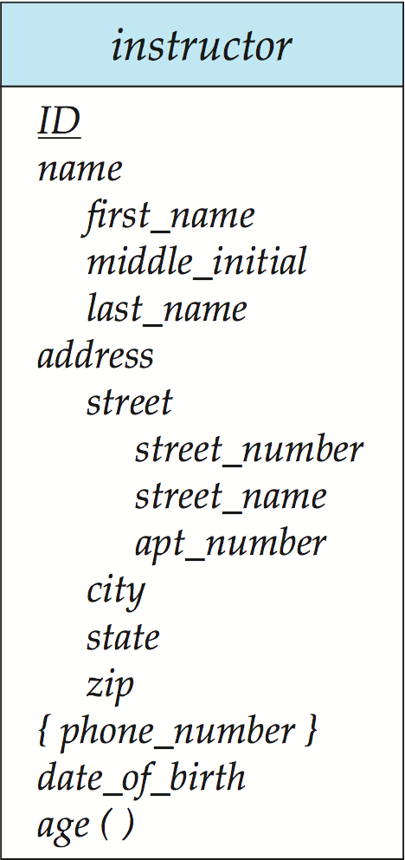
Entity With
Composite,
Multivalued,
and
Derived Attributes

Slide 15
Mapping Cardinality Constraints
Relationship can be one of the following types:
One to one
One to many
Many to one
Many to many

Slide 16
One-to-One Relationship
one-to-one relationship between an instructor and a student
an instructor is associated with at most one student via advisor
and a student is associated with at most one instructor via advisor

Slide 17
One-to-Many Relationship
one-to-many relationship between an instructor and a student
an instructor is associated with several (including 0) students
via advisor
a student is associated with at most one instructor via advisor

Slide 18
Many-to-Many Relationship
An instructor is associated with several (possibly 0) students
A student is associated with several (possibly 0) instructors via advisor relationship
m
n

Slide 19
Conceptional Data Design
with E-R Model
*Requirement Analysis
Decide entity, attributes and relations
Entity-Relation (E-R) diagram

Slide 20
ER Diagram Example :

Slide 21
Logical Database Design
Conceptional Design is used
ER Model is converted to Relational Database Model.
Entity at E-R or Classes in UML --> Table
Many to many relations --> Table
Attributes --> Columns
Primary keys and foreign keys are defined

Slide 22
Physical Database Design
It is Physical implementation of the Logical Model.
Tables, columns, primary key constraints, foreign key constraints,
check constraints, unique constraints, comments are created.
Normalization Rules are checked , redundancy is minimized
Disk capacity, partition strategy, security strategy are considered.
Performance tuning is done.

Slide 23
Most Common Relational Databases
-MySQL -PostgreSQL
-Access -Oracle -IBM Db2 -Interbase -Microsoft SQL Server

Slide 24
Normalization
process of organizing a database into tables correctly
Finally unproblematic tables are designed
that providing Consistency, minimize redundancy
We decide which atributes are used in a table

Slide 25
Normalization Forms
(1NF) First Normal Form
(2NF) Second Normal Form
(3NF) Third Normal Form
(BCNF) Boyce Codd Normal Form
(4NF) Fourth Normal Form
(5NF) Fifth Normal Form

Slide 26
First Normal Form
Domain is atomic in First Normal Form
if its elements are considered to be indivisible units
UNF – Unnormalized Form Example:
staffNo | job | dept | dname | city | contact number
S01 | Salesman | 10 | sales | London | 12345,767642,4982423
S02 | Manager | 20 | accounts | Barking | 351632165
S03 | Clerk | 20 | accounts | Barking
S04 | Clerk | 30 | operations | Barking | 383131267

Slide 27
First Normal Form Example
Sales Table:
id | Name | Address | City | Product | Quantity | Price
1 | Ahmet Seker | Address1 | Ankara | CD-R | 50 | 100
2 | Ahmet Seker | Address1 | Ankara | Mouse | 2 | 2
3 | Ahmet Seker | Address1 | Ankara | CD-R | 50 | 100
4 | Ramazan Kaya | Address2 | İstanbul | DVD-R | 10 | 50
5 | Gokhan Imam | Address3 | Adana | CD-R | 0 | 0
Contains repeating data
There are anomalies while inserting, updating and deleting
Let’s think about avoiding repeating data ..

Slide 28
Second Normal Form Example
Repeating data is prevented
id | Name | Address | City
1 | Ahmet Seker | Address1 | Ankara
2 | Ramazan Kaya | Address2 | İstanbul
3 | Gokhan Imam | Address3 | Adana
Customer table:
Customer id | Product | Quantity | Price
1 | CD-R | 50 | 100
1 | Mouse | 2 | 2
1 | CD-R | 50 | 100
2 | DVD-R | 10 | 50
3 | CD-R | 0 | 0
Sales table:
Let’s think about : What is the anomalies at these tables ? How to avoid?

Slide 29
Anomalies at the Second Normal Form
If adding new city is wanted, a customer should be added
When deleting a customer, the city will also be deleted
So?

Slide 30
Third Normal Form
Tables are divided into new tables
though there is no functionally dependencies
In the example City table will be added
City:
Customer:
City id | Name
c1 | Ankara
c2 | İstanbul
c3 | Adana
id | Name | City id
1 | Ahmet Seker | C1
2 | Ramazan Kaya | C2
3 | Gokhan Imam | C3

Slide 31
Normalization
Advantages :
More efficiently
More accurate data
Less hard drive
Fewer data integrity problems
Disadvantages :
More slower
More complex queries
More work is needed
Unless normalizing, still do its business !

Slide 32
Denormalization for Performance
May want to use non-normalized schema for performance
More tables require more joining operations while querying

Slide 33
What is Denormalization ?
It is a strategy that used to increase the performance
of a database infrastructure
involves adding redundant data
İnvolves combining data from various tables into a single table.

Slide 34
Summary of Physical Database Design
Divide your information into tables regarding main subjects or entities.
Decide which columns will take place in each table
(eg. Surname and StartDate for EMPLOYEES table)
Decide the primary keys for all tables.
A primary key is used to define a record specifically
(eg. Province_code in PROVINCES tables)
Establish the table relations
Analyze each table in order to decide which columns will take place in other tables.
Detail your design
Analyze your design for errors. Create the tables and insert test records to find whether there are anomalies in your design. Make arrangements on your design if necessary.

Slide 35
Summary of Database Design (Cont’d)
Apply normalization rules
Define constraints for integrity :
not null
primary key
unique constraint
check constraints
Foreign keys (References another tables)
Use indexes for performance (DB already creates for PK)

Slide 36
PK – FK RELATIONS
UNIVERSITY
UNIV_CODE(PK)
UNIV_AD
STUDENT
STUDENT_NO(PK)
STUDENT_NAME
UNIV_CODE
UNIV_KOD(FK)
There is master-child relation between university and student
University codes of the Student should be contained in University table
PK and Index are needed

Slide 37
DATABASE DESIGN EXAMPLES
AND MAIN POINTS

Slide 38
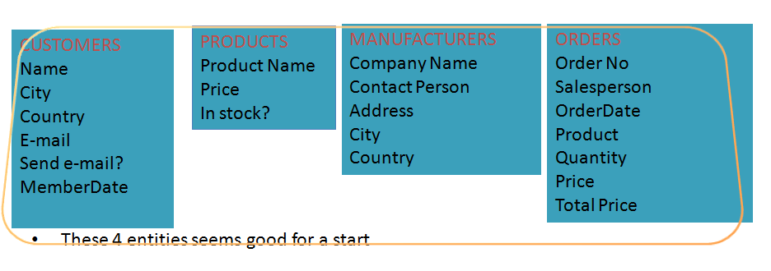
Divide your information into tables
For example, the main entities or subjects for a Product Sales Database
can be designed as below at first:

Slide 39
Divide your information into tables (Cont’d)
If you had designed a single table instead of 4 different tables:
Each record would contain data about both products and manufacturers
You may have many products coming from a manufacturer.
In this case, you need to enter the name and address multiple times causing
unnecessary disk usage. Instead, a MANUFACTURERS table related with a
PRODUCTS table would provide a single record for a manufacturer.
One other anomaly would be seen while manipulating data.
If the address of a company changes, you need to update all the records related
with that company.

Slide 40
Divide your information into tables (Cont’d)
If you had designed a single table instead of 4 different tables:
Another anomaly; Assume a manufacturer has only one product. . If you want to delete this product, but want to keep the Manufacturer’s data, you can not achieve this goal.
Note: create tables(entities) that represent a subject and include columns
only related to that subject.
For example, Manufacturer address is a concept that belongs to manufacturer,
not to product. Hence, this column should be in MANUFACTURERS table.

Slide 41
Decide which columns
will take place in each table
Assume you decided your address column to include country, province, and
districts in a single column (Turkey, Ankara, Çankaya).
If you will produce reports based on province or order the reports by country,
than you’d better divide this field into 3 seperate columns.
(Codes of these locations are preferable)
Seperate Name and Surname columns if surnames are important in your future reports.
No need to include derived columns in tables (eg. Age, Total Price)

Slide 42
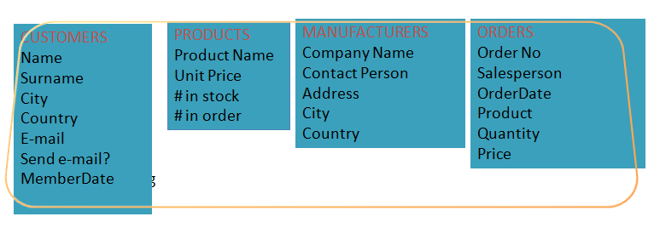
For example, the main entities or subjects for a Product Sales Database
can be designed as below at first:
every table, you are ready to choose the Primary Key of each.

Slide 43
Decide Primary Keys
Primary keys are the main factors that define a record uniquely.
For example, in a PERSONNEL table, SSN is an ideal candidate for being a PK.
PK s can not be null(empty) and can not have a repeating value in a table.
Name is a bad candidate for being a PK for a PERSONNEL,
because you will most probably have records that have the same name.
The PK for a table will probably be a reference (foreign key) for another table.
So, your PK’s should be unchangeable, generally.
An auto-increment number (aka. surrogate key) can also be a PK for some tables
(eg. ORDERS table).
In some cases, your PK may consist of more than one column.

Slide 44
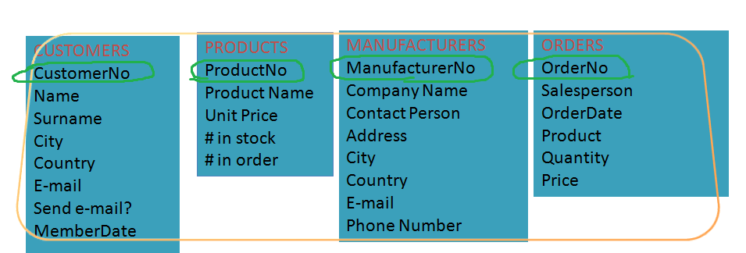
Our tables have Primary Keys:

Slide 45
RELATE THE TABLES
On relational databases, you divide your data into subject based tables
Afterwards, you relate the tables in order to query more than one table at a time.

Slide 46
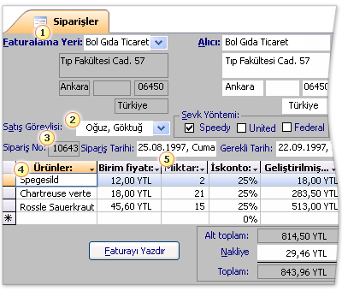
Different parts from different tables at Application

Slide 47
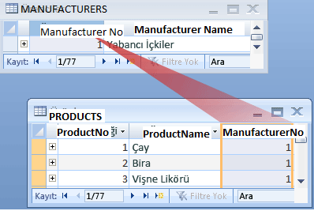
In our Product Orders database, there is MANUFACTURERS table and
PRODUCTS table.
A manufacturer can produce more than one products.
As a result, many rows may exist in PRODUCTS table that belong to a manufacturer.
(1- M Relationship)

Slide 48
1-M Relationship
A Foreign Key must be the Primary key of another table.
It is the most common relationship used when creating relational databases.
A row in a table in a database can be associated with one or (likely) more rows
in another table.
MANUFACTURERS
ManufacturerNo(PK)
Company Name
Contact Person
Address
City
Country
E-mail
Phone Number
PRODUCTS
ProductNo(PK)
Product Name
Unit Price
# in stock
# in order
ManufacturerNo(FK)

Slide 49
M-M Relationship
Let’s decide the relationship between PRODUCTS and ORDERS tables.
A single order may include more than one product.
For every record in PRODUCTS table, more than one record in ORDERS
table may exist.
On the other hand, a product may be involved in more than one order.
For every record in ORDERS table, more than one record in PRODUCTS
table may exist.
Let’s think what kind of problems may arise?

Slide 50
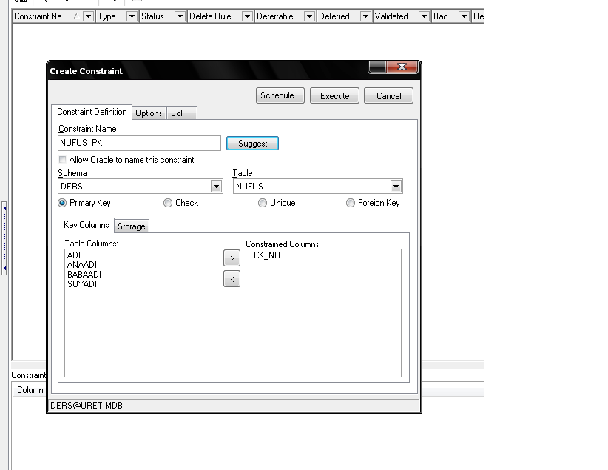
PREVENT DUPLICATION
For example, in the Citizen table, We chose tck_no as pk. :

Slide 51
PREVENT DUPLICATION (Cont’d)
After making the TCK_NO column the Primary Key,
if we want to insert another record with the same TCK_NO :

Slide 52
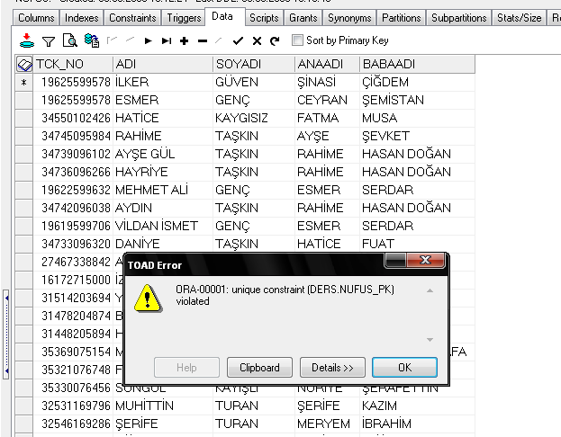
PREVENT DUPLICATION (Cont’d)
After making the TCK_NO column the Primary Key,
if we want to insert another record with the same TCK_NO :

Slide 53
FORCE TO ENTER A VALUE
Another consistency check mechanism is
to force the user to enter a value to columns.
For example, no records with null values in NAME and
SURNAME columns should exist.
To enforce this is also possible with a database constraint.

Slide 54
FORCE TO ENTER A VALUE (cont’d)

Slide 55
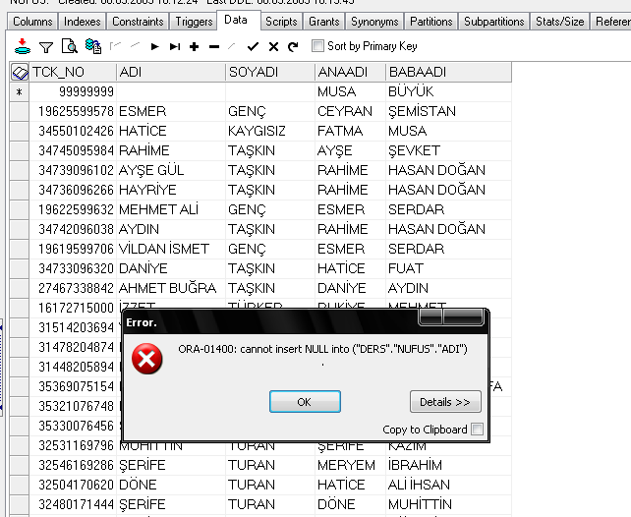
FORCE TO ENTER A VALUE (cont’d)

Slide 56
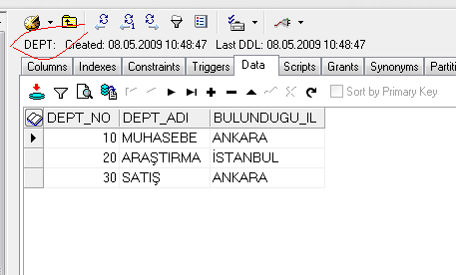
RELATIONAL DATABASES
Assume we have a PERSONEL table that stores personnel data and
a DEPT table that stores the departments in the corporation.
These 2 tables have such records:

Slide 57
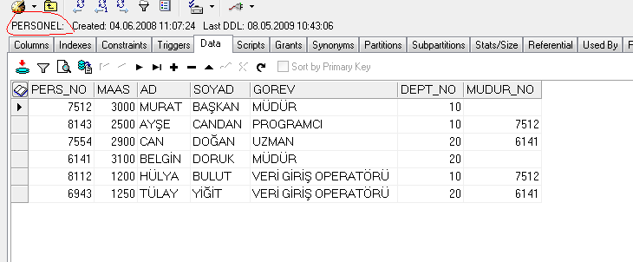
RELATIONAL DATABASES (Cont’d)

Slide 58
RELATIONAL DATABASES (Cont’d)
If you do not put a constraint, one day you may face with a personnel who has a department that does not exist in the DEPT table. Because, for example, data entry people may enter incorrectly while entering quickly
A database constraint must be put for not to face with such a problem. The most important feature of the relational database is the ability to relate these tables and does not allow inconsistent data.

Slide 59
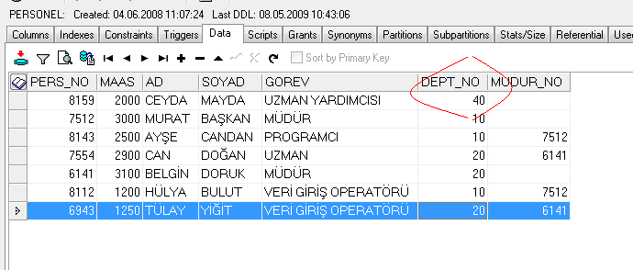
RELATIONAL DATABASES (Cont’d)

Slide 60
RELATIONAL DATABASES (Cont’d)

Slide 61
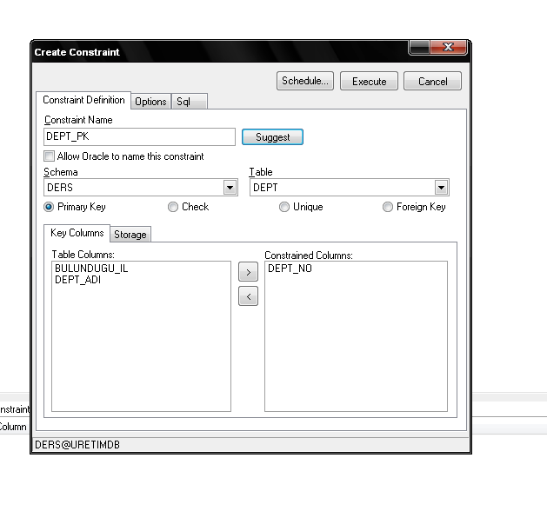
RELATIONAL DATABASES (Cont’d)
To prevent such an inconsistency,
DEPT_NO column of PERSONEL table should be related to
DEPT_NO column of DEPT table.

Slide 62
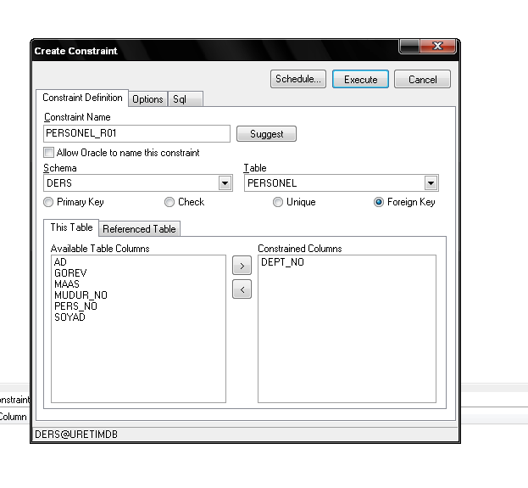
RELATIONAL DATABASES (Cont’d)

Slide 63
RELATIONAL DATABASES (Cont’d)
After relating these 2 tables, the DEPT table is called as master table or parent table or reference table.
PERSONEL table is called as child table.
After this relation, no one can enter a value to PERSONEL.DEPT_NO column that does not exists in DEPT.DEP_NO column.

Slide 64
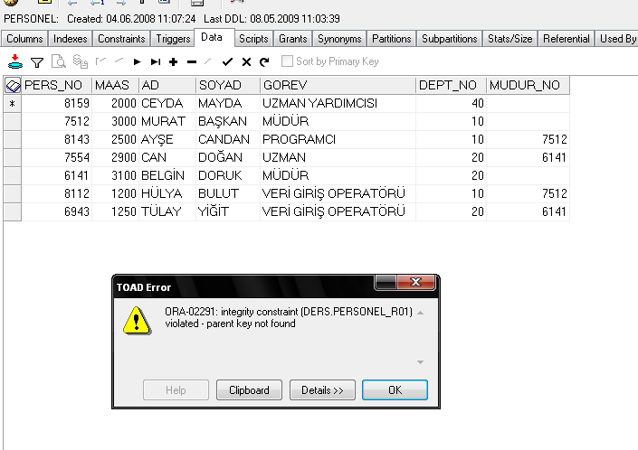
RELATIONAL DATABASES (Cont’d)

Slide 65
RELATIONAL DATABASES (Cont’d)
But similarly, no one can also delete a record from DEPT table that has a child record in PERSONEL table.

Slide 66
RELATIONAL DATABASES (Cont’d)
In a data entry application, the ideal solution for consistent data collection is to create reference tables and establish a PK-FK relation between the tables.
To give an example, if you are making a population census project and the variables on the survey paper include EDUCATION LEVEL, COUNTRY CODE, GENDER the ideal design should be something like this:

Slide 67
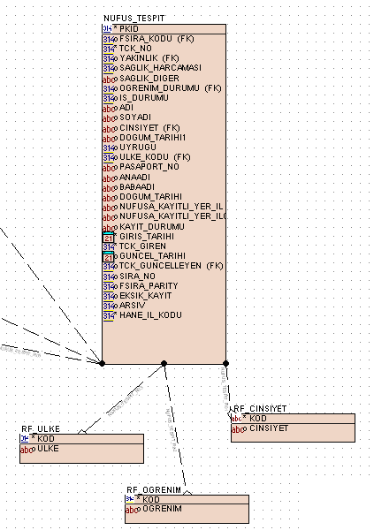
RELATIONAL DATABASES (Cont’d)

Slide 68
RELATIONAL DATABASES (Cont’d)
By this way, you guarantee that unknown values of education level, country code or gender can not be entered to POPULATION table.
You can write your own constraints also in the application programming language like Java, .NET, etc.
But it will be waste of time since any RDBMS guarantees these issues.

Slide 69
CONCLUSION
Database Design Steps are;
Required Analysis
Conceptional Data Design (ER)
Logical Database Design (Relational)
Physical Database Design
Before designing a database; requirements analysis should be done carefully !
Maintenance should be considered while designing
Normalization/Denormalization should be considered, evaluated.
Data integrity, consistency should be guaranteed using constraints
Performance of the system should be also evaluated

Slide 70
Case Study:
We are designing DB system for a shop. Sytem includes products and sales information.
1 ) Please draw the ER diagram for the system
After ER diagram; write table names, columns, undeline the primary keys and foreign keys columns

Slide 71
The requirements of the system are :
Each product has product number, trademark, model, properties, unit price, guarantee period and stock quantity.
Each product belongs to a product group, a product group may contain many products.
The information of the customers -that buy products- are saved. Customers have id, name, surname, address, phone information. When a customer buy a product, invoice is arranged. More than one invoice may be arranged for a customer, but an invoice is arranged for one customer.
There may be more products in an invoice. A product may exist more than one invoice. The price of the sale and the quantity are recorded.
More than one payment is available for a sale. Each payment has date and paid price.
** Hint : You may Underline objects to find entities and their attributes

Slide 72
invoiceDate
quantity
price
trademark
productId
Invoice
m
invoiceId
Has
n
Product
model
n
1
properties
price
Arranged
n
name
Made
quantity
surname
Is
Guarantee_period
1
custId
Customer
n
1
Payment
address
paymentNumber
Product Group
phone
payment
Date
amount

Slide 73
Tables of the database:
Customer (customerId, name, surname, address, phone)
Invoice (invoiceId,invoiceDate, customerId)
Product (productId, trademark,model,properties,unitPrice,guranteePeriod,
quantity, productGroupId)
ProductGroup (productGroupId, name)
Payment (invoiceId , paymentNumber, date, amount)
Sale (saleId, invoiceId, productId, quantity, salePrice)

