Slide 1
SQL FUNDEMANTALS
31.03.2014
(Muscat, Oman)

Slide 2
OUTLINE
Definition of SQL
Main Categories Of Sql
Basic Sql Commands
Nested Queries and Subqueries
Set Operators (minus, in, not in, all, some, intersect, exists)
Aggregate Functions
Join Operations
Using View and Matearilized View
Sequences
Triggers And The Purpose Of Triggers

Slide 3
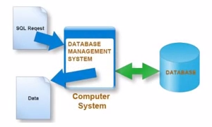
SQL DEFINITION
SQL (Structured Query Language) is
a special-purpose programming language
designed for managing data held in a RDBMS
First developed in the early 1970s at IBM
Commercially released by Relational Software Inc.
Became a standard of the
American National Standards Institute (ANSI) in 1986
International Organization for Standards (ISO) in 1987

Slide 4
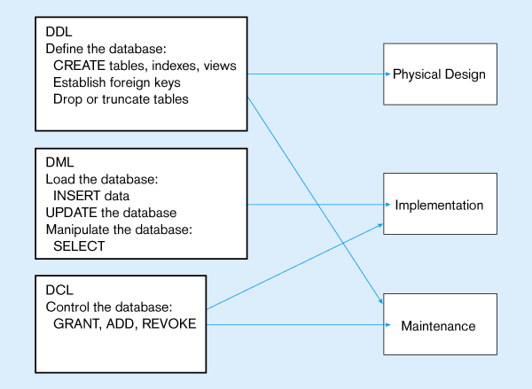
MAIN CATEGORIES

Slide 5
Sql Commands Overview
CREATE TABLE <name> ( <field> <domain>, … )
INSERT INTO <name> (<field names>)
VALUES (<field values>)
DELETE FROM <name>
WHERE <condition>
UPDATE <name>
SET <field name> = <value>
WHERE <condition>
SELECT <fields> (distinct is usable here)
FROM <name>
WHERE <condition>

Slide 6
Some Examples
Sailors
sid | sname | rating | age
22 | Dustin | 7 | 45.0
29 | Brutus | 1 | 33.0
31 | Lubber | 8 | 55.5
32 | Andy | 8 | 25.5
58 | Rusty | 10 | 35.0
64 | Horatio | 7 | 35.0
71 | Zorba | 10 | 16.0
74 | Horatio | 9 | 35.0
85 | Art | 3 | 25.5
95 | Bob | 3 | 63.5
Reserves
sid | bid | day
22 | 101 | 10.10.1998
22 | 102 | 10.10.1998
22 | 103 | 10.08.1998
22 | 104 | 10.07.1998
31 | 102 | 11.10.1998
31 | 103 | 11.06.1998
31 | 104 | 11.12.1998
64 | 101 | 09.05.1998
64 | 102 | 09.08.1998
74 | 103 | 09.08.1998
Boats
bid | bname | color
101 | Interlake | blue
102 | Interlake | red
103 | Clipper | green
104 | Marine | red
*Live Demo : install and use a DBMS for SQL s

Slide 7
Examples of Basic SQL Queries
Example : select distinct sname, age from sailors
Q1 : Find all sailors with a rating above 7.
Q2 : Find the sailors that rating>7
Q3 : Find the sailors that whose name starts with ‘B’ letter
Q4 : Find the names of the sailors who reserved at least one boat

Slide 8
Nested Queries and Subqueries
A subquery is a select-from-where expression
that is nested within another query.
Example Query:
Find courses offered in Fall 2009 and in Spring 2010
select distinct course_id
from section
where semester = ’Fall’ and year= 2009 and
course_id in (select course_id
from section
where semester = ’Spring’ and year= 2010);

Slide 9
Using Set Operators
(MINUS, NOT IN, NOT EXISTS, IN, EXISTS, INTERSECT)
Syntax : Query1 <Set Operator> Query2
Example1: (difference)
Select * from staff_1 Minus Select * from staff2;
Select * from staff_1 where staff_number not in (select staff_number from staff_2);
Select * from staff_1 a where not exists (select * staff_2 b where a.sid=b.sid);
Example2: (intersect)
Select * from staff_1 intersect Select * from staff2;
Select * from staff_1 where staff_number in (select staff_number from staff_2);
Select * from staff_1 a where exists (select * staff_2 b where a.sid=b.sid);

Slide 10
Exercises:
Q5: Find the sailors that rating of the one equals 3 times of the other
(hint: result is Art, Bob, Horatio)
Q6:Find the names of sailors who have red or green boat
Q7: Find the names of sailors who have reserved a red and a green boat
Q8: Find the sname of sailors who have reserved red boats but not green boats
*Live Demo

Slide 11
Answers:
Q7 Answer -1 ( It is a complex query )
Select s.sname
from sailors s, reserves r 1, boats b1, r 2, boats b2
where s.sid = r1.sid and r1.bid=b1.bid
and s.sid = r2.sid and r2.bid=b2.bid
and b1.color=‘red’ and b2.color=‘green’;
Q7 Answer -2 – Using Intersect operation (easily to understand, write)
Select s.sname
from sailors s, reserves r , boats b
where s.sid = r.sid and r.bid=b.bid and b.color=‘red’
INTERSECT
Select s2.sname
from sailors s2, reserves r 2, boats b2
where s2.sid = r2.sid and r2.bid=b2.bid and b2.color=‘red’ ;

Slide 12
Q8 Answer:
Find the sname of sailors who have reserved red boats but not green boats.
Select s.sname
from sailors s, reserves r , boats b
where s.sid = r.sid and r.bid=b.bid and b.color=‘red’
MINUS
Select s2.sname
from sailors s2, reserves r2, boats b2
where s2.sid = r2.sid and r2.bid=b2.bid and b2.color=‘green’;

Slide 13
ALL, SOME,ANY
They are used to compare two datasets
Example:
Find names of instructors with salary greater than that of some (at least one)
instructor in the Biology department.
Answer-1 :
select distinct T.name
from instructor as T, instructor as S
where T.salary > S.salary and S.dept_name = ’Biology’;

Slide 14
Same query using some clause
select name
from instructor
where salary > some (select salary
from instructor
where dept_name = ’Biology’);
Same query using any clause
select name
from instructor
where salary > any (select salary
from instructor
where dept_name = ’Biology’);

Slide 15
Example Query for All Clause
Find the names of all instructors whose salary is greater than
the salary of all instructors in the Biology department.
select name
from instructor
where salary > all (select salary
from instructor
where dept_name = ’Biology’);

Slide 16
UNION vs UNION ALL
They concetane the result of two different SQLs.
They differ in the way they handle duplicates.
Selected columns need to be of the same data type
There is a performance hit when using UNION vs UNION ALL,

Slide 17
AGGREGATE FUNCTIONS
avg: average value
min: minimum value
max: maximum value
sum: sum of values
count: number of values
Find the average salary of instructors in the Computer Science department :
select avg (salary) from instructor where dept_name= ’Comp. Sci.’;
Find the total number of instructors who teach a course in the Spring 2010 semester:
select count (distinct ID) from teaches where semester = ’Spring’ and year = 2010;

Slide 18
..GROUP BY
Attributes in select clause outside of aggregate functions must appear
in group by list
  /* erroneous query */
select city, student_name, count(*), avg(average_note) note from student
group by city

Slide 19
Used for queries on single or multiple tables
Clauses of the SELECT statement:
  SELECT
    List the columns (and expressions) that should be returned from the query
  FROM
    Indicate the table(s) or view(s) from which data will be obtained
  WHERE
    Indicate the conditions under which a row will be included in the result
  GROUP BY
    Indicate columns to group the results
  HAVING
    Indicate the conditions under which a group will be included
  ORDER BY
    Sorts the result according to specified columns

Slide 20
AGGREGATE FUNCTIONS EXERCISES
*Live Demo :
Exercise:
Using STUDENT table
STUDENT(student_name, lesson_name, note)
Find:
a) The count of lessons for each student
b) The average note, and maximum note of each student
c) Find the students that have more than 1 record for the same lesson

Slide 21
Solutions of the Exercise:
select student_name, max(note), avg(note), count(lesson_name) from student
group by student_name;
select student_name, lesson_name, count(*) from student
group by student_name, lesson_name
having count(*) > 1;

Slide 22
JOIN OPERATIONS
Join operations take two relations and return as a result another relation.
A join operation is a Cartesian product which requires that tuples in the
two relations match (under some condition).
It also specifies the attributes that are present in the result of the join
The join operations are typically used as subquery expressions
in the from clause

Slide 23
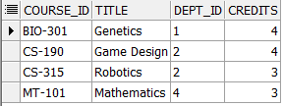

JOIN EXAMPLES
Course :
Department:

Slide 24

JOIN EXAMPLES (Cont’d)
select t1.course_id, t1.title, t1.credits, t2.*
from COURSE t1, department t2
where t1.dept_id = t2.dept_id;

Slide 25
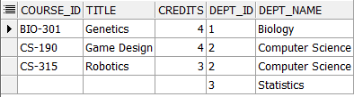
JOIN EXAMPLES using Right Outer Join
select t1.course_id, t1.title, t1.credits, t2.*
from COURSE t1, department t2
where t1.dept_id(+) = t2.dept_id;
select t1.course_id, t1.title, t1.credits, t2.*
from COURSE t1 right outer join department t2
on t1.dept_id = t2.dept_id;

Slide 26
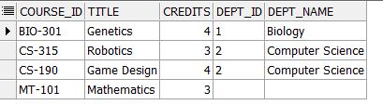
JOIN EXAMPLES using Left Outer Join
select t1.course_id, t1.title, t1.credits, t2.*
from COURSE t1, department t2
where t1.dept_id = t2.dept_id(+);
select t1.course_id, t1.title, t1.credits, t2.*
from COURSE t1 left outer join department t2
on t1.dept_id = t2.dept_id;

Slide 27
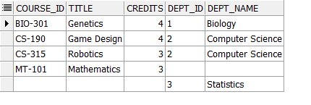
JOIN EXAMPLES using Full Outer Join
select t1.course_id, t1.title, t1.credits, t2.*
from COURSE t1
full outer join
department t2
on t1.dept_id = t2.dept_id;

Slide 28
Some Easy but useful SQL statements
Create table t1 as select * from t2;
Select * from t1 where rownum < 100;
Deleting duplicate records example:
for table Student(student_name, lesson_name, note)
delete from STUDENT A1 where exists
(Select 'x' from STUDENT A2
where A1.STUDENT_NAME = A2.STUDENT_NAME
and A1.LESSON_NAME = A2.LESSON_NAME
and A1.NOTE = A2.NOTE
and A1.ROWID > A2.ROWID);

Slide 29
Views and Materialized Views
A view is a result set of a query
By using views, showing only relevant data to the users is provided.
Create view statement : create view <view_name> as < query expression >
Materializing a view: create a physical table containing all the tuples
in the result of the query defining the view (refresh is required)
create materialize view <mview_name> as < query expression >

Slide 30
SEQUENCES
A sequence is a database object that generates numbers in sequential order.
Mostly used to generate primary key for a table
Example:
To create the sequence:
CREATE SEQUENCE customer_seq INCREMENT BY 1 START WITH 100
To use the sequence to enter a record into the database:
INSERT INTO customer (cust_num, name, address)
VALUES (customer_seq.NEXTVAL, 'John Doe', '123 Main St.‘);

Slide 31
TRIGGERS
Trigger is a procedure that is automatically run by DBMS in response to
specified changes to the database, and performs desired events
Trigger has three parts : Event, Condition, Action
Trigger Types Are :
DML triggers for Insert, Update, Delete
DDL triggers (instead of) for Create, Alter, Drop, etc..
Triggers can’t be defined for Select statement
<!> Transactions statements (commit, savepoint,rollback)
can not be used in Triggers

Slide 32
TRIGGER EXAMPLES
create or replace trıgger delete_forbidden
before drop on database
begın
raıse_applıcatıon_error ( -20000,’dropping table is forbidden’);
end;
create or replace trigger trigger_1
before insert on tbl1
referencıng new as new old as old for each row
begin
:new.referenced_date := sysdate;
end tr_1;

Slide 33
SUMMARY
Basic SQL query has a Select, From,Where
Use Distinct to avoid duplicates at queries
SQL provides set operations: Union, Intersect, Minus,
Queries that have subqueries are called Nested Queries.
In, Exists, Unique, Any, All, Some is used for Nested Queries
Aggregators operators are Count, Sum, Average, Max,Min
Group by and Having
SQL provides using of Sequences and Triggers
Key Points:
Be careful about recursive triggers !
Think about check constraints instead of triggers for database consistency.

