Slide 1
DATA WAREHOUSE
31.03.2014 (Muscat, Oman)

Slide 2
OUTLINE
Users Problems and necessity for Data Warehouse
BI Definition and Components
Data Warehousing Concepts
DW Goals and Objectives
OLAP and OLTP terms
Data Warehouse vs: Operational DBMS
Datamarts methodology
Explanation of Star Schema and Snowflake Schema
DMQL (Data Mining Query Language)
OLAP Functions

Slide 3
INTRODUCTION
There are 2 types of users: Operational users and Decision-Maker users
Operational users use local data while decision-makers use historical data
Database design is changed if data is used for take decision.
Data Warehousing is used for take decisions
Data Warehouses captures data different operational sources
Data Warehouses contain historical data

Slide 4
Operational Data :
local data
gets frequent updates and queries
specific queries are needed
Operational user
Historical Data:
“tells” about something
Very infrequent updates
Integrated data
Analytical queries that require huge amounts of aggregation
Query Performance is crucial
Decision maker

Slide 5
Example OLTP queries:
What is the salary of Mr .Johnson ? (point query)
What is address and phone number of Mr. Johnson ? (point query)
How many employees have received an 'excellent' credential in the last
appraisal?
Example OLAP queries:
Is there a correlation between the geographical location of a company
and profit of the company?
How is the age of the employee effect their performance ?
Is gender of a staff effect the performance ?

Slide 6
Data Problems and necessity for Data Warehouse
Without DW :
Data is everywhere and hard to manage
Same data is exist at different places
Data inconsistency
It is hard to deploy new data
Data is so complex and detailed
Data can not be analysed
There isn’t time series

Slide 7
DECISION SUPPORT SYSTEM and The Origin of BUSINESS INTELLIGENCE
DECISION SUPPORT SYSTEM is a general name of any system
to support decision-makers in the decision process.
DSS is the origin of the Business Intelligence system
Business intelligence is designed to support the process of decision-making

Slide 8
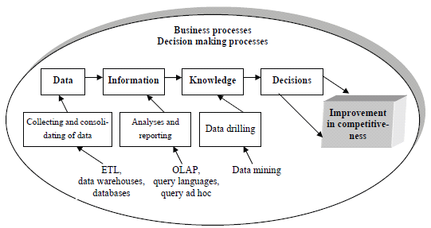
BI Definition
Business intelligence system –
A set of integrated tools, technologies and programmed products
used to collect, integrate, analyze, and make data (Koronios & Yeoh, 2010).
The Role of BI in decision making (Olszak & Ziemba, 2007, Figure 2, p.137)

Slide 9
Business Intelligence Systems:
Includes all technologies for gathering and analysing data
Provide the input to strategic and tactical decions at senior managerial levels
Managerial level don’t need daily information, they need historical, strategical data.
Companies invest large amount of money to BI technologies

Slide 10
Query driven Approach and
Data Warehouse based
Disadvantages of Query driven Approach:
Data is up to date, slowly queries because of transactions
Historical data doesn’t exist
The Query Driven Approach needs complex integration and filtering processes, aggregation. So it is slow.
This approach is very inefficient
This approach is very expensive for frequent queries
Competes with local processing at sources

Slide 11
Data Warehousing Approach
This is the approach commonly used in BI systems.
In this approach; the information from multiple heterogeneous sources is integrated in advance and stored in a warehouse.
There is another database other than running database.
The data in the database is stored in a data warehouse in periodically.
Users don't access database directly, they access Data Warehouse for querying.
This approach provides high performance.
Data Warehouse also contains historical data

Slide 12
BI Components
Data Warehouse (also called as OLAP systems)
OLAP Cubes
Dashboards
ETL (Extract, Transform, Load)
Data Mining

Slide 13
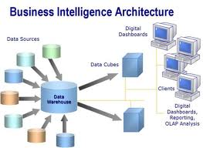
(ETL)
Data Mining
Take decision
Decision-makers use dashboard that contains report, analysis, chart, maps, etc.

Slide 14
Some Definitions of Data Warehousing
Data warehouse –
A subject oriented, collection of data used to support decision making in
organizations (Anderson et al., 2008).
Data warehousing - A systematic approach to collecting relevant
business in order to organize
and validate the data so that it can be analyzed to support
business decision making
(Cody et al., 2002).
A Data Warehouse is a subject-oriented, integrated, time-varying, non-volatile
collection of data that is used primarily in organizational decision making.”
-- W.H. Inmon, Building the Data Warehouse, 1992

Slide 15
A Data Warehouse is...
Subject-oriented, Organized by subject, not by application
Used for analysis, data mining
Optimized differently from transaction-oriented database
Single repository of information
Data Warehousing involves data cleaning, data integration and data consolidation
Supports analytical reporting, ad-hoc queries and decision making
User interface aimed at executive

Slide 16
Data Marts
A data mart is a subset of the data warehouse. This data is specific to a particular group . Data warehouses are collection of "data marts".
Data marts are also seen as small warehouses for OLAP activities
It deals with specific information. For example, although a data warehouse includes the all data of an organization, a data mart includes the data of a department. The data mart is organized for regarding people. So these people don’t need to understand all the data, it is sufficient to understand the regarding data mart.
Management and autherization would be easierr when using data marts.

Slide 17
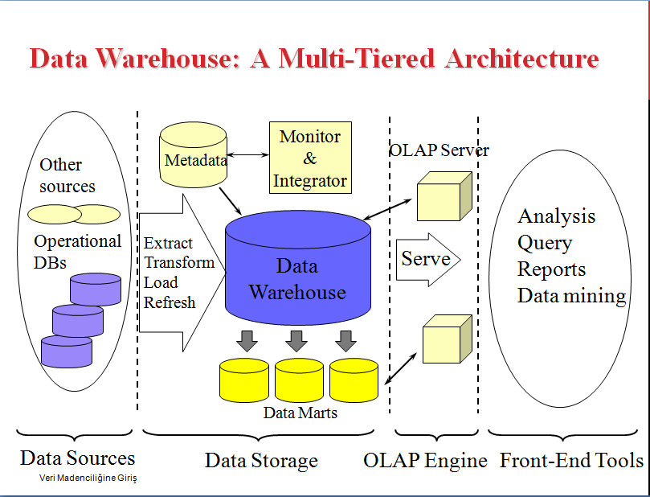
Generic Warehouse Architecture

Slide 18
Differences Between Operational Systems and Data Warehousing Systems
An operational database stores information about the activities of an organization
The purpose of an operatioanal system is
providing online querying and processing, daily routines
Operational systems are also called as OLTP (Online Transactional Processing)
Data Warehouses help users to data analyze and make decisions
Warehouse is a Specialized DB
Data Warehousing Systems are also called as OLAP (Online Analytical Processing)

Slide 19
OLAP vs OLTP

Slide 20
Types of OLAP Servers
Multidimensional OLAP (MOLAP) : array-based multi dimensional storage
Relational OLAP(ROLAP) : Uses Relational Database. Includes aggregation, additional tools and services.
Hybrid OLAP (HOLAP) : Both MOLAP and ROLAP
Specialized SQL Servers

Slide 21
OLAP CUBES
Data cube help us to represent data in multiple dimensions.
The data cube is defined by dimensions and facts. The dimensions are the entities with respect to which an enterprise keeps the records.
OLAP cube is the main object of the OLAP. This cube is a multi-dimensional cube. The components of a cube are:
fact table, dimension tables and measures.
The cube concept is used to understand multi-dimensional model better.
Data cubes are used for people that don’t have advanced database knowledge. The cubes are capable of analyzing data from multiple dimensions.
Relational databases are not suitable for very large data. So, OLAP cube is created from these data for an easy analyze.
If there are more than 3 dimensions in a cube, it is called hypercube.

Slide 22
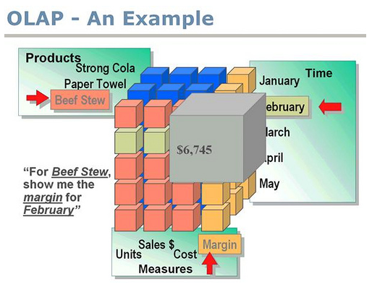
OLAP CUBE Example

Slide 23
(Modelling Types) Schema Types
in Data Warehousing
Some modelling types:
Star Schema
Flat schema
Terraced Schema
Snowflake Schema
Star Cluster Schema
Fact Constellation Schema , ..
Data normalization in DW is not as important as OLTP systems

Slide 24
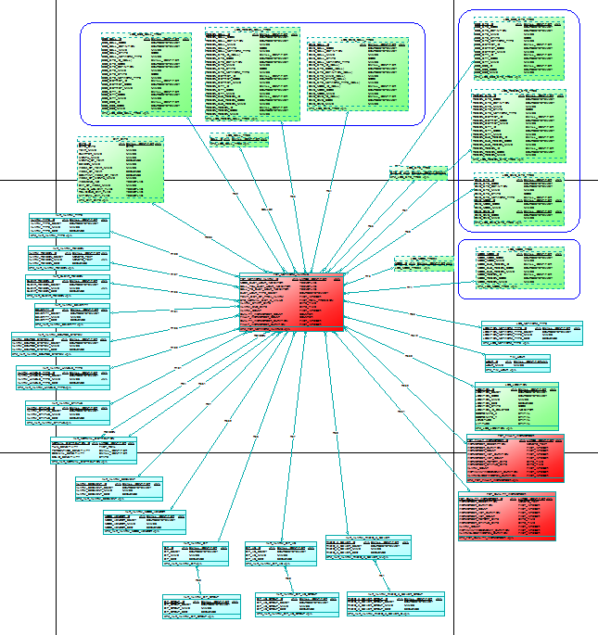
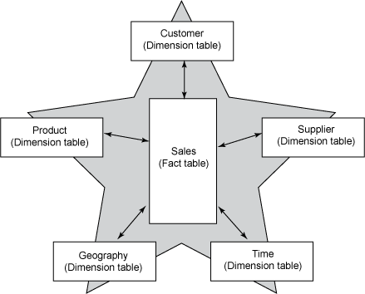
Star Schema

Slide 25
Charecteristics of Fact and Dimension Tables
Fact table:
Contains numeric values that called measurements
Contains huge size of data
Expand fast and quickly
Includes stable, derived, summarized, aggregated data
Have foreign key relation with dimension tables
Dimension tables:
Are Reference tables
Generally includes text type data that users want to see
Generally includes static data
Data size is low

Slide 26
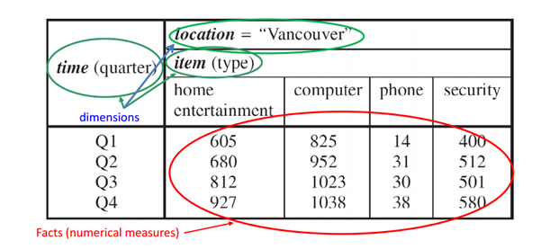
Example:
Table 1: 2-D view of sales data according to the dimensions time and item, where location is ‘Vancouver’.
The mesure displayed is dollar in thousand

Slide 27
Example:
Table 2: 3-D view of sales data according to the dimensions time, item and location.
The measure displayed in dollar-sold in thousand

Slide 28
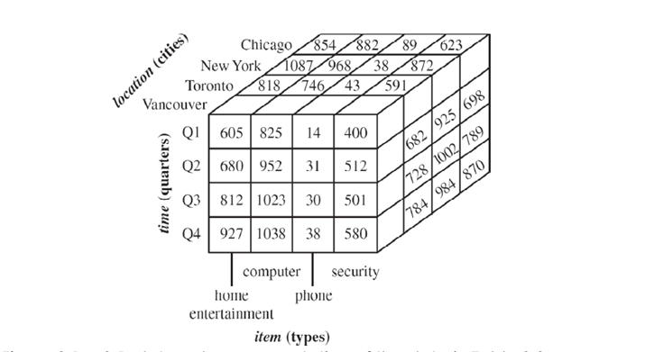
Example:
3-D data cube representation of the data in table 2

Slide 29
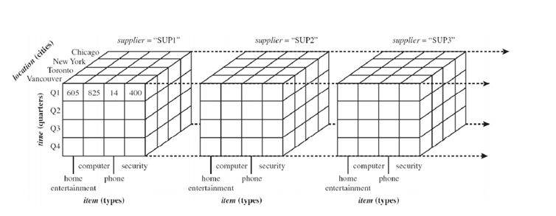
Example:
4-D data cube representation, according to the dimensions time, item, location and supplier

Slide 30
Snowflake Schema
There is only one fact table
Some dimension tables are normalized
Due to normalization,
redundancy is reduced
therefore it becomes easy to maintain and save storage space

Slide 31
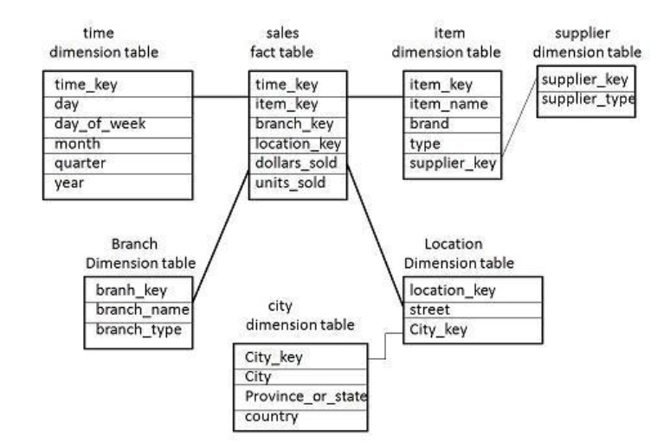
Snowflake Schema Example

Slide 32
Data Mining Query Language ( DMQL)
DMQL is a SQL based language. First, it is developed for data mining process.
But, It can be also used for describing data warehouses elements.
SYNTAX FOR CUBE DEFINITION
define cube < cube_name > [ < dimension-list > }: < measure_list >
SYNTAX FOR DIMENSION DEFINITION
define dimension < dimension_name > as ( < attribute_or_dimension_list > )

Slide 33
DMQL (Data Mining Query Language) Examples
Star Schema of Sales Cube Definitons:
define cube sales star [time, item, branch, location]:
dollars sold = sum(sales in dollars),
define dimension time as (time key, day, month, year)
define dimension item as (item key, item name)
define dimension location as (location key, street, postal code, city)

Slide 34
The Conversion of a Relational Database into a Multidimensional Database
Find Subjects and Data Marts
Find all dimensions that exist but are hidden in a relational database schema
Knowledge (measurements)

Slide 35
OLAP OPERATIONS
Roll-up : Performs aggregation on a data cube
Drill-down : reverse of the roll-up
Slice : Performs selection on a dimension of a cube
Dice : Performs selectşon on two or more dimensions
Pivot (rotate) : It rotates data axes

Slide 36
SUMMARY
OLAP vs OLTP
BI components are DW, OLAP, Cubes, Dashboards, ETL and Data Mining
DW is subject oriented data and used in Decision Support Systems
DW is also called OLAP
DW includes time dimension, historical data
Querying and analysing data is easy on DW system
Generally managers use DW to query
Star-Schema structure is used in DW at most (fact, dimensions, measures)

Slide 37
Thank You & Any Question ?

