Slide 1
DATA PROCESS and Data Warehouse Projects in TURKSTAT
31.03.2014 (Muscat, Oman)

Slide 2
Information Technologies Department
Information Technologies
Department
Harzemli Software
Development
Group
Management Software Group
Network and System Management Group
IT Support
Group
Data Management
Group

Slide 3
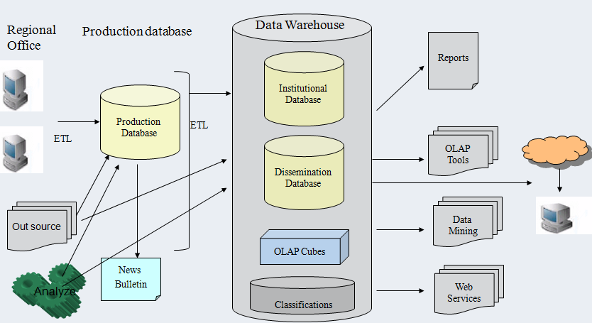
TurkStat Data Architecture

Slide 4
TurkStat Databases
Production Database :
Current data is stored and always transaction in it.
Institutional Database (Enterprise Database):
The main repository of TurkStat‘s harmonized historical data.
Dissemination Database :
Aggregated time series data created from TurkStat institutional databases.
Up to now there are
62 institutional databases
59 dissemination databases
Oracle DBMS is used for all database

Slide 5
Production Databases
Mainly data entry systems
Database for web applications
OLTP(Online Transactional Processing)
Surveys data are stored in this database
Huge amount of data entry and frequent data manipulation(inserts, updates, deletes)
Various but not costly SQLs
Supports thousands of concurrent users
We developed a new generic system (Harzemli) that produces surveys generic using DDL. Regional Offices use this program on the netbooks.

Slide 6
Institutional (Enterprise) Databases
Institutional database has analysed, harmonized and controlled consistency
eventual time series data.
Only for internal users.
User roles are defined for the statistical units on the newly created
institutional databases.
The statistical units can access only their own data using SAS codes ,
and just have select right.
They can never delete, update, insert data by themselves.
It is necessity for all departments to work in coordination with IT Department
during the creation process of institutional databases.

Slide 7
Dissemination Databases
Dissemination databases are the summary aggregated data repository
which are created from institutional databases
according to the information request
The dissemination database is served on the TurkStat web page
They are READ-ONLY system
For external users, only confidental data is available
It is free of charge, shown on web page
Since it is open to whole world, supports many concurrent users

Slide 8
There are aggregated time-series data about 62 subjects.
End users can easily get desired data with the help of interface programs
and dynamic reports
The current web-based programmes are developed by our programmers with
ZK framework and Oracle reports
We are developing a new Central Dissemination Project
that will show all dissemination data by one software programme

Slide 9
The main benefits of distinction to these 3 database is:
To maintain different business processes on different servers.
An advantage is performance. While we are making a bulk insertings or queries on instutional database, dissemination database doesn’t effect these procedures. So the performance would not be decreased.
Another advantage is only aggregated data are served to internet users and access to micro data is prevented

Slide 10
Data Harmonization
The main subject of the Institutional databases is
harmonization of different data
After carefull investigations and analyses,
it has been seen that our main problems comes from
using different classifications from year to year and projects to projects
Such as
Branch of economic activity
Occupational group
Educational status
Marital Status
Administrative Structure
Dictionary tables

Slide 11
Data Warehouse in Turkstat
Being holded in our relational institutional database
Designed as star schema model
ROLAP (Relational OLAP) which means that all OLAP cubes are on relational database

Slide 12
Data Warehouse in Turkstat (Cont’d)
Being holded in our institution at the scope of European Union projects,
Creating data warehouse process was started in 2006 , with SAS
And a prototype data warehouse consists of 1985, 1990 and
2000 population censuses were formed
Oracle BI suite is used.

Slide 13
Data Warehouse in Turkstat (Cont’d)
8 data warehouses / OLAP projects with 48 data marts:
2000 Population Census
1990 Population Census
1985 Population Census
Labour Force Statistics
Municipal Waste Statistics
Municipal Water Statistics
Foreign Trade Statisics
Demographical Statistical
Datawarehouses in Institutional database. There are different schemas for each Datawarehouse.
SQL Procesures are used as ETL, to producing DW data.

Slide 14
Oracle BI Suite
OBIEE 11g is includes :
OBIEE Administration Tool
OBIEE Interface
BI Publisher

Slide 15
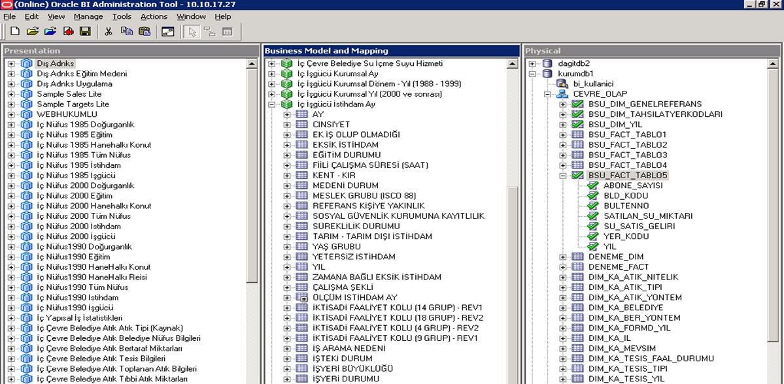
OBIEE Administration Tool

Slide 16
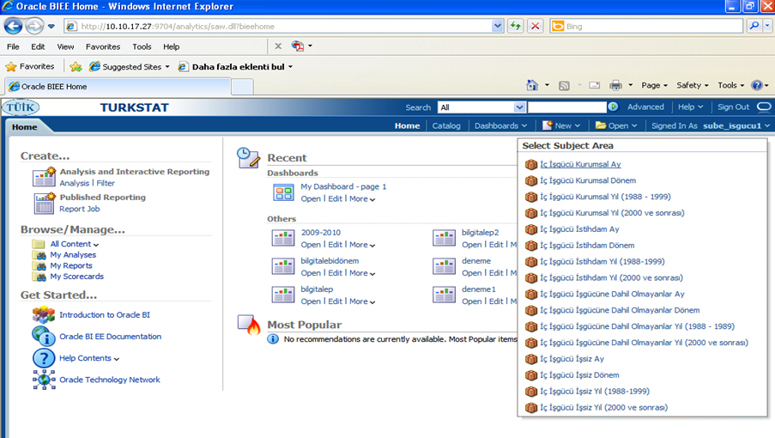
OBIEE Interface

Slide 17
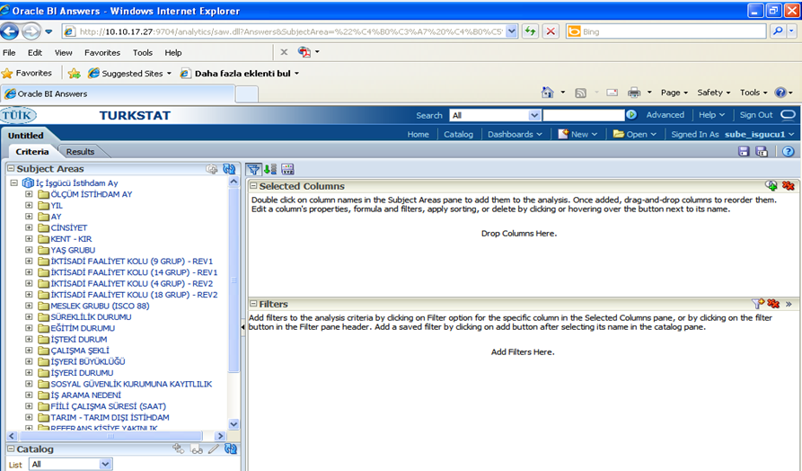
OBIEE Interface

Slide 18
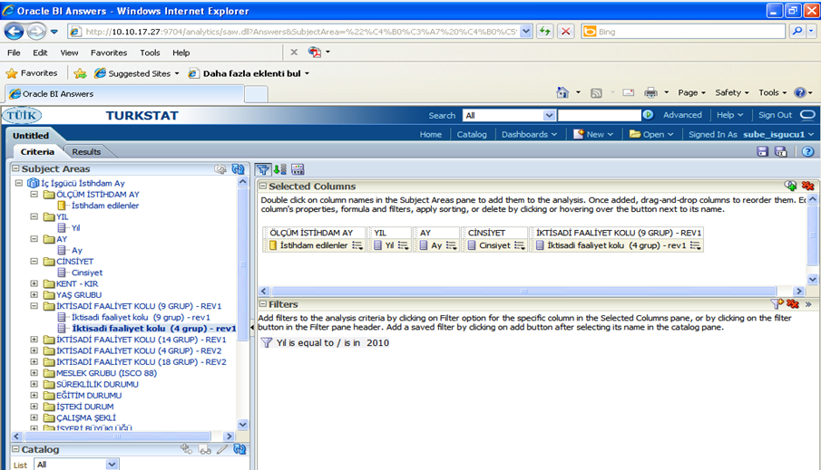
OBIEE Interface

Slide 19
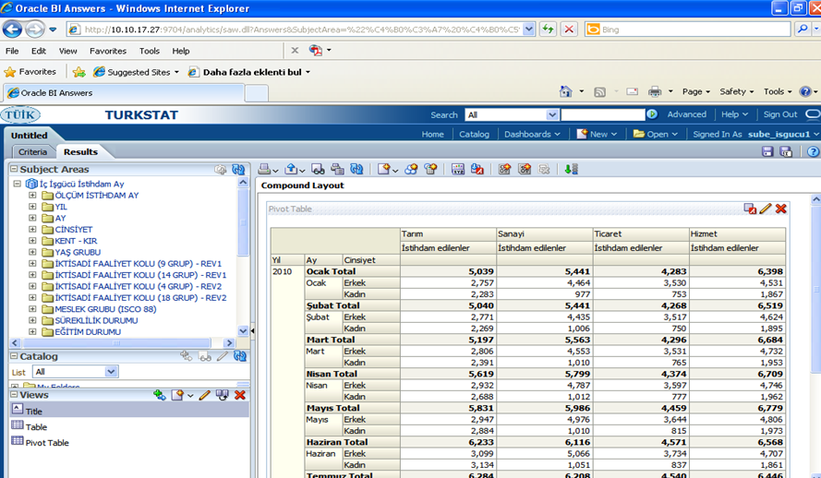
OBIEE Interface (pivot table)

Slide 20
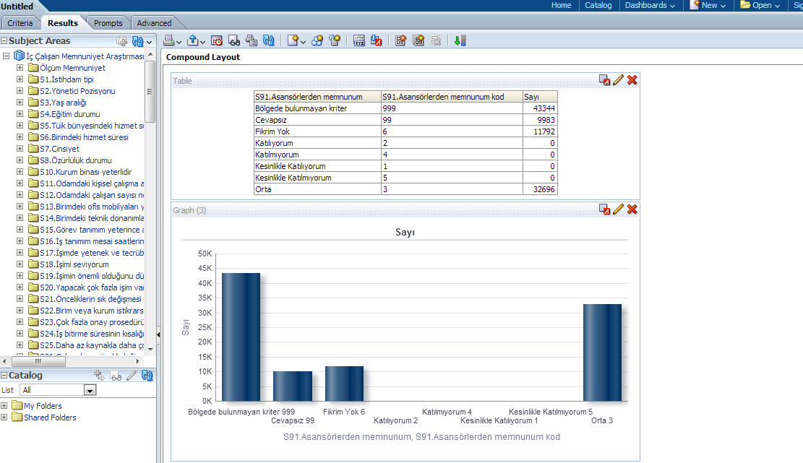
OBIEE Interface (table and chart)

Slide 21
OBIEE Interactive Dashboards
Simply containers for reports and other content (like chart, maps..)
Allows multiple reports to be displayed in a tabbed interface
Used to provide highly summarized and graphical content

Slide 22
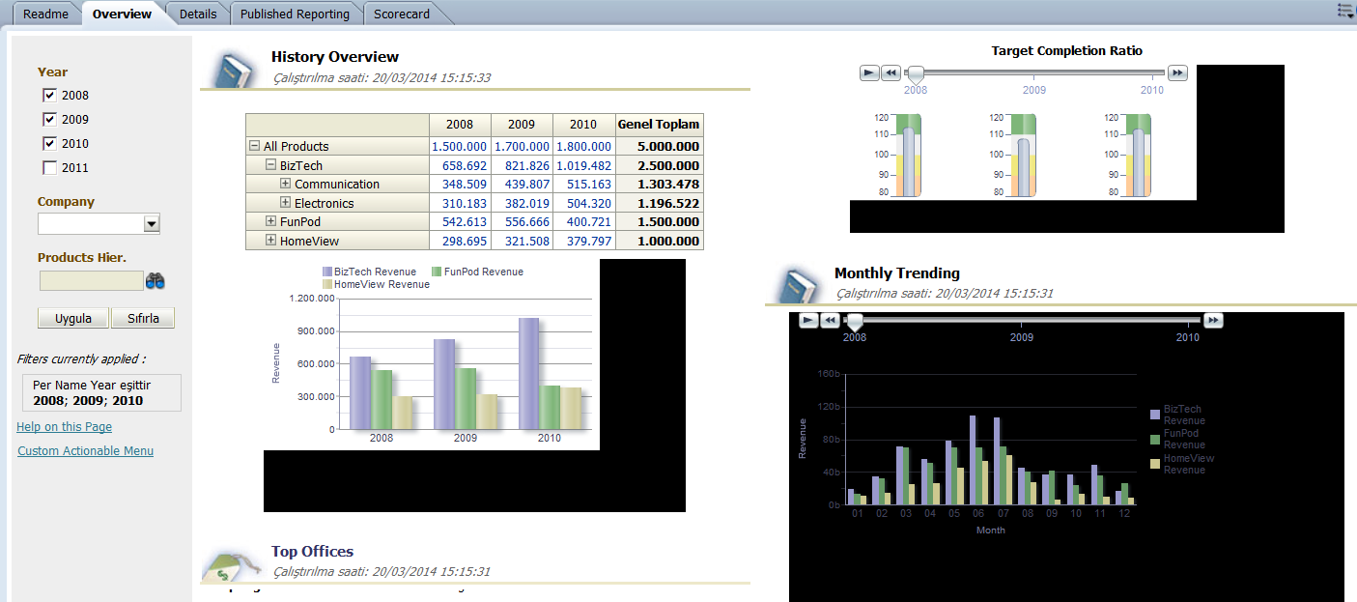
An Example Interactive Dashboard

Slide 23
Summary
Databases of the TurkStat are Production, Institutional and Dissemination
Seperating databases to 3 database is useful both performance, management, confidentality
We have some Data Warehose Projects developed by Oracle BI Suite
Oracle BI suite has Administarion Console, Presentetion Interface, Reports Building tool
Dashboards are containers that can include various and dynamic reports, maps, charts etc., and give very easy and valuable data to the users

