Slide 1
ETL PROCESS
31.03.2014
(Muscat, Oman)

Slide 2
OUTLINE
        ETL Definition
        Extraction Process
        Transformation Steps
        Loading into Data Warehouse
        ETL Tools
        Case Studies

Slide 3
DEFINITION
Component of BI
ETL is the set of process that includes
extraction, transformation and loading data
Data warehouses are supplied by ETL processing
Data are moved from sources to target databases
It is A very costly and time consuming part of data warehousing
ELT : Extract – Load – Transform
Difference from ETL is semantic.

Slide 4
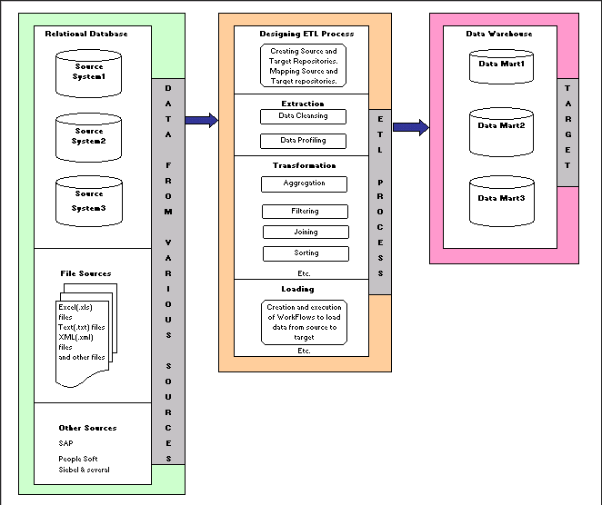

Slide 5
EXTRACTION
Extraction
Data is extracted from data sources
Different systems may exist
  DBMS
  Operating Systems
  Hardware
  Communication protocols
Needs logical data map document that includes
rules, sources and target tables definitons
Various
Operational
Data
ETL System
Data Warehouse

Slide 6
TRANSFORMATION
Transformation is the main step where the ETL adds value
Actually changes data and provides guidance for its intended purposes
İncludes : aggregation/disaggregation, sorting, cleaning dirty data,
Checking for data integrity and applying business rules
Could be done by SQL codes or ETL tools

Slide 7
Dirty Data:
What is the dirty data ?
1) Lack of Standardization
- Multiple encoding, locales, languages..
- Different abbreviations (Mareşal Fevzi Çakmak Streeet , Mar. Fev. Ç. Street)
- Semantic equivalence (Gaziantep, Antep, G. Antep)
- Multiple standards : 1.6 miles is the same as 1 kilometer
Because OLTP s are different cities or different countries, different abbreviations or standards may be used)

Slide 8
Dirty Data (Cont’d)
2) Missing, incorrect and duplicate data
- Missing age field for an employee
- Incorrectly entered values
- Duplication of datasets across OLTP units
- Semantic duplication
what is the correlation the age of the staff between their performance ? We need to know age .
3) Inconsistencies
- Incorrect use of codes
(M/F is used somewhere, 0/1 is used in others for gender)
there could be inconsistent data..
- Referential inconsistency (for example there is 24 as department id, although there isn't a department which id is 24)

Slide 9
Transformation – Data Cleaning
  Dirty data is cleaned in transformation processs.
  While cleaning data,
    standardizing is important. So, Companies decide on the standards.
  Data cleaning is not a simple issue
It is not automatically and required considerable knowledge
Complexity increases with increasing data sources
For example ; there is one km in a record; and there is 1 mile in a record.
Or there may be abbreviation of a street
You should know geography, metrics, so on to compare and clean data.

Slide 10
Data Cleaning Steps
Data Analysis : Analyse data set to obtain meta-data and detect dirty data
Definiton of transformation rules
Rule Verification : Verification of the transformation rules on test data sets
Transformation : Execution of transformation rules on dataset
Back flow: Re-populating data sources with cleaned data

Slide 11
Transformation – Confirming DB Structure
  Tables should :
  have proper primary and foreign keys
  obey referential integrity
  simple business rules
  Provide logical data checks

Slide 12
LOADING
Loading is the third part of the ETL process
Loading is performing transformed data to the target Data Warehouse
Data is physically moved to Data Warehouse
Data Warehouse is a star-schema
To provide data integrity : first dimension tables and then fact tables are loaded
Generally only change data is loaded

Slide 13
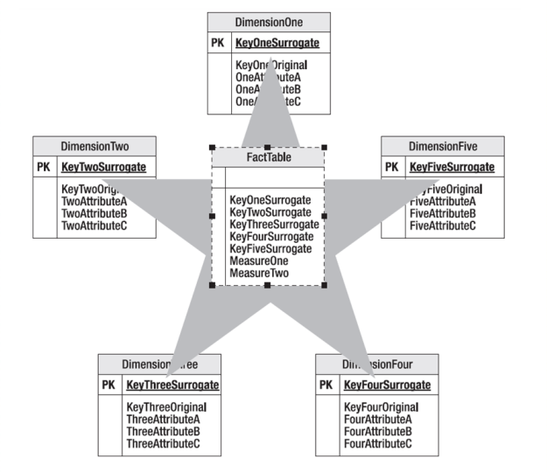
Loading to DW
Dimension tables have a surrogate key, Normal key and attributes,
Surrogate key should be a unique integer, a single field While normal key may have multiple field.

Slide 14
Slowly Changing Dimensions
The "Slowly Changing Dimension" problem is a common one particular to data warehousing.
Briefly, this applies to cases where the attribute for a record changes over time.
We give an example:
Customer Id | Name | City
1001 | Ahmet ak | Ankara
Later he moved to İstanbul.
How should company modify its customer table to reflect this change? This is the "Slowly Changing Dimension" problem.

Slide 15
There are three ways to solve this type of problem, and they are categorized as follows:
Type 1: The new record replaces the original record. No trace of the old record exists.
Type 2: A new record is added into the customer dimension table. Therefore, the customer is treated essentially as two people.
Type 3: The original record is modified, but the old value is also kept.

Slide 16
Type 1 Dimension
The new information simply overwrites the original information. In other words, no history is kept.
New record will be:
Customer Id | Name | City
1001 | Ahmet ak | İstanbul
This is the easiest way to handle the Slowly Changing Dimension problem.
But the historical data is lost. Company doesn’t know the previous city of the
Customer.
This type can be used when history of data is not important.

Slide 17
Type 2 Dimension
A new record is added to the table to represent the new information. Therefore, both the original and the new record will be present. The new record gets its own primary key.
Result will be :
Customer Id | Name | City
1001 | Ahmet ak | Ankara
1002 | Ahmet ak | İstanbul
In this approach, history of data is kept. But, the size of the table will increase.
And ETL process will be complicated.
When tracking the changes is important, this type of dimension could be used.

Slide 18
Type 3 Dimension
In Type 3 Slowly Changing Dimension,
There will be two columns to indicate the particular attribute of interest, one indicating the original value, and one indicating the current value.
There will also be a column that indicates when the current value becomes active (date value)
After Customer moves to İstanbul, the table will be shown as below:
customer_id | name | original_city | current_city | effective_date
1001 | Ahmet Ak | Ankara | İstanbul | 24.03.2014
Keeps some historical data, (only 1 historical data, here)
size is not increasing more.
This type is rarely used.

Slide 19
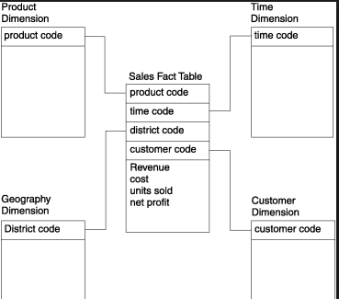
Loading Fact Tables
Fact table consists of
Dimensions’ keys
Measures

Slide 20
Metadata Repository
Metada defines warehouse objects
It stores:
Description of the structure of the data warehouse
Operational meta-data
The algorithms used for summarization
The mapping from operational environment to the data warehouse
Data related to system performance
Business data, business rules

Slide 21
Most Popular ETL Tools are:
Informatica
Power CenterIBM
SAP - BusinessObjects Data Integrator
IBM - Cognos Data Manager
Microsoft - SQL Server Integration Services
Oracle - Data Integrator
SAS - Data Integration Studio
Oracle - Warehouse Builder
Open Source Examples: Pentaho, Talend,..

Slide 22
Advantages of ETL Tools
The single greatest advantage of an ETL tool is that it provides a visual flow of the system’s logic.
It also provides attractive, self documentation.
These tools provide monitoring the ETL system.
Manual coded is also useable in ETL tools.
Finding data dependencies will be easier if needed after or before any change.
These tools have cleanining functionality.
Performance may be better in some situations.
Using an ETL tool will be easier for inexperienced developer.

Slide 23
Disadvantages of ETL Tools
Software licensing cost is the most important disadvantage.
There is uncertainty in many ETL teams. They may use only few features of the Tools. Finding experienced ETL team is difficult.
Sometimes, flexibility is limited. They have some limits and experience is needed.
Developers may resist to use a new tool

Slide 24
So, Should we use an ETL tool ? ..
Because, each company has different data size, business rules, etc. ,, tool necessity should be evaluated according to their criterias.
So decision is changed for each company.

Slide 25
Key Points:
ETL is often a complex combination of process and technology
ETL is not a one-time event
It should be performed periodically (monthly, daily, hourly)
Should be automated, well documented and easily changeable
Steps are; data cleaning, integrating and loading
First dimensions, then fact table are loaded
There are some useful ETL tools but they are not always necessary

Slide 26
Thank you & Questions ?

