Slide 1
DATA MINING
31.03.2014
(Muscat, Oman)

Slide 2
OUTLINE
Definition of Data Mining
Using Areas of Data Mining
Data Mining Tasks
Some examples about Data Mining Methods

Slide 3
Data , Information and Knowledge
DATA
INFORMATION
KNOWLEDGE
(Raw facts) (Organized facts and figures)
(Meaningful information, helps to make decision)
Data is anything that recorded and processed by computers. Data is raw fact, may be numeric or text format.
"Information" is "data" that has been processed.
Information can be converted into knowledge . We make decisions using knowledge.
Example 1:
Company 1 | 25 TL
Company 2 | 30 TL
Company3 | 10 TL
Company 4 | 40 TL
Data : 25, 30, 10, 40
Information : These are prices of the st. For these companies
Knowledge : the cheapest one is company3, deciding to buy

Slide 4
Problem ? :
Huge and Meaningless Data
Data is not valueable while querying with traditional methods
How can we get knowledge to compete ?
Solution :
Data Mining Process

Slide 5
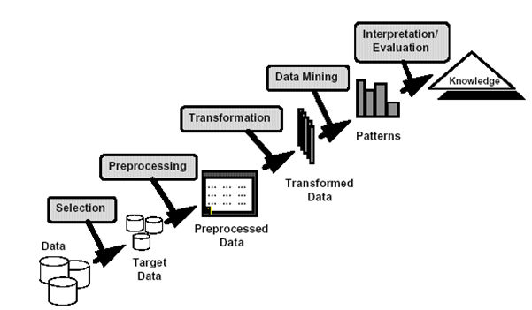
DATA MINING OVERVIEW
Data Mining is the process of analyzing data from different perspectives
and summarizing it into useful information
  Data Mining is knowledge discovery from data

Slide 6
DATA MINING APPLICATION AREA EXAMPLES
Medical / Pharma
  Computer Assisted Diagnosis (expert systems learning)
  Characterization/prediction of patient's response to product dosage
  Identification of successful medical therapies (successful prescription patterns).
  Study of relations between dosage and potentially related adverse events
Banking / Finance
  Detection of fraudulent credit card usage patterns.
  Risk management related to attribution of loans using scorecards.
  Find hidden correlations between different financial indicators.
  Identification of stocks trading rules from historical market data.
Retail / Marketing
  Discovery of buying behavior patterns
  Detection of associations among customer characteristics.
  Prediction of the probability that clients answer to mailing.

Slide 7
Some Possible Questions :
Banking :
Does he take a new credit card or manage to pay it
Stock market
Will gold prices increase
Shopping market:
Which items are frequently purchased
Does he interest new fashion shoes/hats/clothes
Hospital:
Which ilness may be..
How long does it take to recover from this illness
?
Answers:
Looking historical data or finding correlation with Data Mining

Slide 8
DATA MINING & DATA WAREHOUSING & OLTP
OLTP system includes transactional data, unnecessary data for analysing
Data Warehouses is designed for analysis
Data warehouses are subject based, fast
Data warehouses are designed to use in decision support systems
Data Mining is performed on Data Warehouses

Slide 9
Data Mining Tasks
1. Defining Problem is the first task. May be it is the most important phase because, according to the purpose, using methods and rules will be changed.
The goal should be clear.
Some Example Goals:
Is there a relationship between gender and education ?
Is there a relationship between travelling expenditure and education?
What type of customer does have problem with paying their loan?

Slide 10
Data Mining Tasks (Cont’d)
2. Preparing data :
This phase takes most time.
While preparing data, data is taken from different sources. Then all data is combined and cleaned. Sometimes, generating new variables is needed.
Not only the size but also the quality of the data is very important.
After providing data quality, modelling task will begin.
3. Modelling task is performed using different methods.
Data Mining tools are used
After modelling finished, it will be evaluated and used.

Slide 11
Data Mining Methods
Prediction Methods
  Some variables are used to predict unknown or future values of other variables.
  Example : classification, regression, deviation detection , decision trees
Description Methods
  Find human-interpretable patterns that describe the data.
  Example: clustering, assocation rule discovery,..

Slide 12
DECISION TREE EXAMPLE
Example : Use these data to predict the risk of a customer.
Customer | Loan | Income | Status | Risk
1 | high | bad | employer | bad
2 | high | high | employee | bad
3 | high | low | employee | bad
4 | Low | low | employee | good
5 | low | low | employer | bad

Slide 13
DECISION TREE
A - node
loan:high
loan :low
BAD
B - node
income:low
income:high
C - node
GOOD
Status : employer
Status : employee
BAD
GOOD

Slide 14
REGRESSION ANALYSIS
The goal of the regression analysis is finding Relationship among variables
Regression analysis is a process of finding releationships between
Y variable and other X1,X2,….Xn variables.
It includes many techniques for modelling and analyzing several variables
A Regression equation example is :

Slide 15
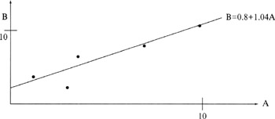

Example2 : Regression Analysis
A (independent variable) | B (dependent variable)
1 | 3
8 | 9
11 | 11
4 | 5
3 | 2

Slide 16
Some Popular Data Mining Tools:
SAS Enterprise Miner
IBM SPSS Modeler
ORACLE Data Mining
RapidMiner (Open Source)
Pentaho (Open Source)

Slide 17
Summary
Data Mining is the process of getting information from data
Before modelling, determining the goal is most important
The quality of the data is also very important
Data Mining is performed on Data Warehouses
Data Mining has prediction and description methods
Some Data Mining Tools are used for the Data Mining process

Slide 18
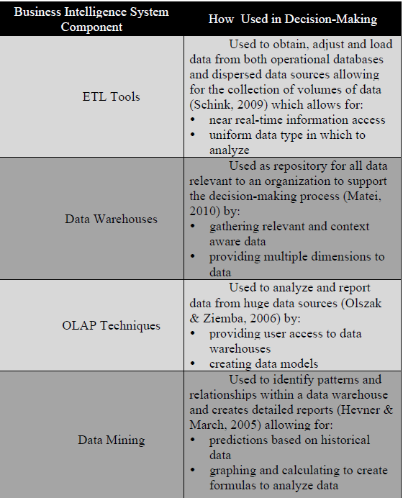
Summary of
Business Intelligence
Components:

Slide 19
Thank you & Questions ?

